Slide 1


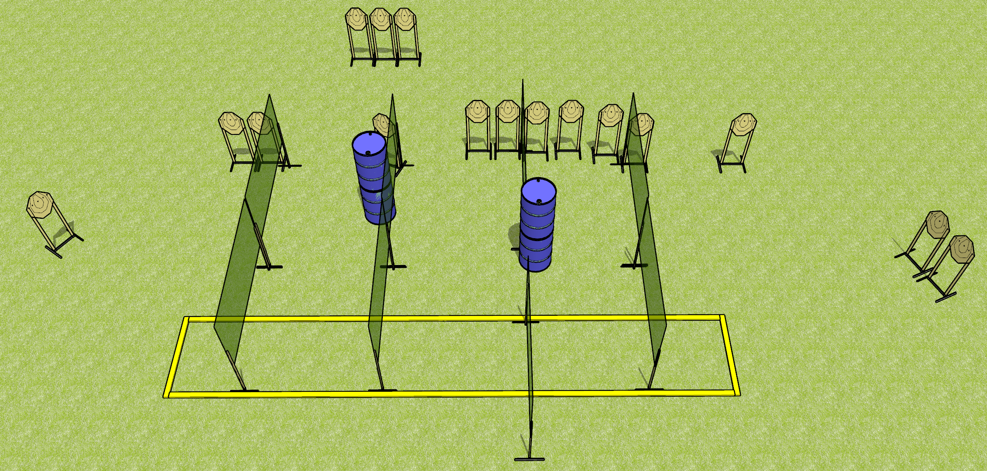
 | Dothan Gun Club – USPSA Match Turtle Massacre Course Designer : Drew Coleman
Round Count 32 rounds 16 IPSC
Equipment List 13 wall feet 2 medium fault lines Make shooting area 30 feet wide

Slide 2
Turtle Massacre
Written Stage Briefing
Turtle Massacre is a 32 round, 160 point, Comstock course of fire. There are 16 IPSC targets. The best 2 hits on paper will score. The start signal is audible.
Handgun start position is anywhere outside the shooting area, wrists below belt. Handgun is loaded and holstered.
PCC start position is anywhere outside the shooting area, stock on belt. Loaded carbine is held with both hands, safety on.
On start signal, engage targets as they become available from within the shooting area.

